Slide 1
ANTENNA WAVE PROPAGATION
MS. HEMA D RAUT
EXTC DEPARTMENT
SIES, GRADUATE SCHOOL OF TECHNOLOGY

Slide 2
Antenna Wave propagation
Wave propagation
Types of wave propagation
Ground wave propagation
Surface wave propagation
Space wave propagation
Earth’s atmosphere
Ionosphere Structure and its effect on wave propagation
Sky wave propagation
Important parameters - Critical frequency, Angle of incidence, Maximum usable frequency, Skip distance, Virtual height.

Slide 3
Wave propagation
Wave propagation
It is the physics term for the movement of waves.
Radio wave (EM wave) propagation
The way radio signals are transmitted from one point to another inside the earth’s atmosphere or free space.
Since these are electromagnetic waves, they exhibit properties such as reflection, refraction, diffraction, absorption, polarization and scattering.
Like light waves, radio waves can be reflected, refracted, diffracted, absorbed, polarized and scattered.

Slide 4
Wave propagation
Reflection and Refraction of waves
Whenever waves are passing from one medium to other reflection and refraction occurs.
For both reflection and refraction, it is assumed that the surfaces involved are much larger than the wavelength; if not, diffraction will occur
Diffraction
The bending of wave around sharp edges and corners of obstacles (reduces the signal strength) appearing in their path is called as diffraction.
In the obstructed or shadow region, the received signal strength depends on position of the receiver and geometrical shape of the obstruction.
Diffraction allows the signals to propagate in regions which lie behind the obstruction.
Example : If the receiver is placed behind an obstruction such that the LOS path is completely obstructed, then due to diffraction phenomenon, the field can still have enough strength to reach the receiver.

Slide 5
Wave propagation
Scattering:
Change in direction of a signal. It occurs due to imperfect medium/structural inhomogenities .
The size of the Structural inhomogenities (obstacles) are much smaller than wavelength.
Scattering causes wave (signals) to deflect in multiple directions

Slide 6
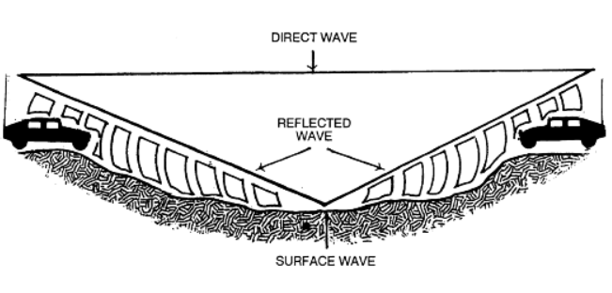
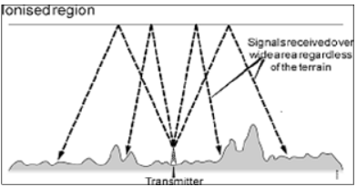
Types of wave propagation
There are two principal ways in which electromagnetic (radio) energy travels from a transmitting antenna to a receiving antenna.
TYPES OF WAVES
GROUND WAVES SKY WAVES.
Ground waves are radio waves that travel near the surface of the Earth (surface and space waves).
Sky waves are radio waves that are reflected back to Earth from the ionosphere.

Slide 7
Ground wave propagation
Depending on whether the wave travels through the space or the surface. The ground waves are further classified as
GROUND WAVES
SURFACE WAVE SPACE WAVE
A surface wave travels along the surface of the Earth.
A space wave travels over the surface.

Slide 8
Surface wave propagation
A surface wave can follow the contours of the Earth because of the process of diffraction.
As a surface wave passes over the ground, the wave induces a voltage in the Earth. The induced voltage takes energy away from the surface wave, thereby weakening, or attenuating, the wave as it moves away from the transmitting antenna.
To reduce the attenuation, the amount of induced voltage must be reduced.
This is done by using vertically polarized waves that minimize the extent to which the electric field of the wave is in contact with the Earth.
When a surface wave is horizontally polarized, the electric field of the wave is parallel with the surface of the Earth and, therefore, is constantly in contact with it.
The wave is then completely attenuated within a short distance from the transmitting site.

Slide 9
Surface wave propagation
When the surface wave is vertically polarized, the electric field is vertical to the Earth and merely dips into and out of the Earth's surface.
For this reason, vertical polarization is vastly superior to horizontal polarization for surface wave propagation.
The attenuation that a surface wave undergoes because of induced voltage also depends on the electrical properties of the terrain over which the wave travels.
The best type of surface is one that has good electrical conductivity. The better the conductivity, the less the attenuation.
The wave with high frequencies and shorter wavelengths, are not normally diffracted but are absorbed by the Earth at points relatively close to the transmitting site.
Thus as the frequency of a surface wave is increased, the more rapidly the surface wave will be absorbed, or attenuated, by the Earth. Because of this loss by attenuation, the surface wave is impractical for long-distance transmissions at frequencies above 2 MHz.

Slide 10
Surface wave propagation
On the other hand, when the frequency of a surface wave is low enough to have a very long wavelength, the Earth appears to be very small, and diffraction is sufficient for propagation well beyond the horizon.
In fact, by lowering the transmitting frequency into the very low frequency (VLF) range and using very high-powered transmitters, the surface wave can be propagated great distances.
Example: The Navy's extremely high-powered VLF transmitters are actually capable of transmitting surface wave signals around the Earth and can provide coverage to naval units operating anywhere at sea.

Slide 11
Space wave propagation
The space wave follows two distinct paths from the transmitting antenna to the receiving antenna—one through the air directly to the receiving antenna, the other reflected from the ground to the receiving antenna.
The primary path of the space wave is directly from the transmitting antenna to the receiving antenna. So, the receiving antenna must be located within the radio horizon of the transmitting antenna.
Because space waves are refracted slightly, even when propagated through the troposphere, the radio horizon is actually about one-third farther than the line-of-sight or natural horizon.
Although space waves suffer little ground attenuation, they nevertheless are susceptible to fading. This is because space waves actually follow two paths of different lengths (direct path and ground reflected path) to the receiving site and, therefore, may arrive in or out of phase.
If these two component waves are received in phase, the result is a reinforced or stronger signal. Likewise, if they are received out of phase, they tend to cancel one another, which results in a weak or fading signal.

Slide 12
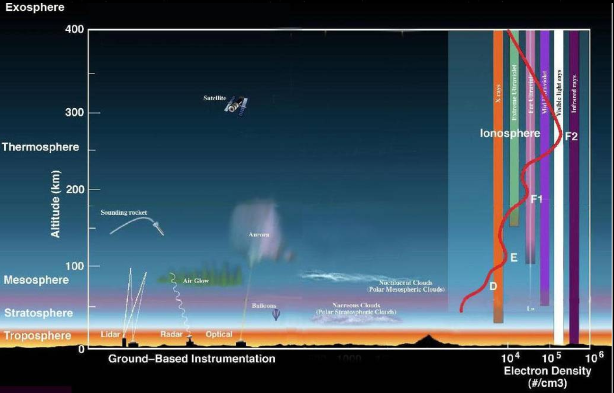
Earth’s atmosphere

Slide 13
Earth’s atmosphere
Earth’s atmosphere has several layers. These layers play an important role in the wireless communication.
Troposphere: The troposphere starts at the Earth's surface and extends 8 to 14.5 kilometers high (5 to 9 miles). This part of the atmosphere is the most dense. Almost all weather is in this region.
Stratosphere: The stratosphere starts just above the troposphere and extends to 50 kilometers (31 miles) high. The ozone layer, which absorbs and scatters the solar ultraviolet radiation, is in this layer.
Mesosphere: The mesosphere starts just above the stratosphere and extends to 85 kilometers (53 miles) high. Meteors burn up in this layer

Slide 14
Earth’s atmosphere
Thermosphere: The thermosphere starts just above the mesosphere and extends to 600 kilometers (372 miles) high. Aurora (the first appearance of light in the morning) and satellites occur in this layer.
Ionosphere: The ionosphere is an abundant layer of electrons and ionized atoms and molecules that stretches from about 48 kilometers (30 miles) above the surface to the edge of space at about 965 km (600 mi), overlapping into the mesosphere and thermosphere. This dynamic region grows and shrinks based on solar conditions and divides further into the sub-regions: D, E and F; based on what wavelength of solar radiation is absorbed. The ionosphere is a critical link in the chain of Sun-Earth interactions. This region is what makes radio communications possible.
Exosphere: This is the upper limit of our atmosphere. It extends from the top of the thermosphere up to 10,000 km (6,200 mi).

Slide 15
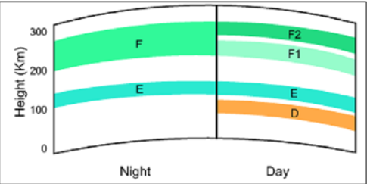
Ionosphere Structure and its effect on wave propagation
Importance of Ionosphere
The ionosphere is composed of three layers designated D, E, and F, from lowest level to highest level.
The D layer ranges from about 30 to 55 miles. Ionization in the D layer is low because it is the lowest region of the ionosphere. This layer has the ability to refract signals of low frequencies. High frequencies pass right through it and are attenuated. After sunset, the D layer disappears because of the rapid recombination of ions.
The E layer limits are from about 55 to 90 miles. The rate of ionic recombination in this layer is rather rapid after sunset and the layer is almost gone by midnight. This layer has the ability to refract signals as high as 20 megahertz. For this reason, it is valuable for communications in ranges up to about 1500 miles.

Slide 16
Ionosphere Structure and its effect on wave propagation
Importance of Ionosphere
The F layer is further divided into two layers designated F1 (the lower layer) and F2 (the higher layer). The presence or absence of these layers in the ionosphere and their height above the Earth varies with the position of the sun. At high noon, radiation in the ionosphere directly above a given point is greatest. At night it is minimum.
The F layer exists from about 90 to 240 miles. During the daylight hours, the F layer separates into two layers, the F1 and F2 layers. The ionization level in these layers is quite high and varies widely during the day. At noon, this portion of the atmosphere is closest to the sun and the degree of ionization is maximum. Since the atmosphere is rarefied at these heights, recombination occurs slowly after sunset. Therefore, a fairly constant ionized layer is always present. The F layers are responsible for high-frequency, long distance transmission.

Slide 17
Ionosphere Structure and its effect on wave propagation
Importance of Ionosphere
The ionosphere layer is a very important consideration in the phase of wave propagation because of the following reasons
The layer below ionosphere has higher amount of air particles and lower UV radiation. Due to this, more collisions occur and ionization of particles is minimum and not constant.
It is appropriately named the ionosphere because it consists of several layers of electrically charged gas atoms called ions. The ions are formed by a process called ionization
The rate at which ionization occurs depends on the density of atoms in the atmosphere and the intensity of the ultraviolet light wave, which varies with the activity of the sun.
Lower frequency ultraviolet waves penetrate the atmosphere the least; therefore, they produce ionized layers at the higher altitudes. Conversely, ultraviolet waves of higher frequencies penetrate deeper and produce layers at the lower altitudes.
An important factor in determining the density of ionized layers is the elevation angle of the sun, which changes frequently. For this reason, the height and thickness of the ionized layers vary, depending on the time of day and even the season of the year.

Slide 18
Sky wave propagation
The sky wave, often called the ionospheric wave, is radiated in an upward direction and returned to Earth at some distant location because of refraction from the ionosphere. This form of propagation is relatively unaffected by the Earth's surface and can propagate signals over great distances. Usually the high frequency (hf) band is used for sky wave propagation.
Radio waves in the LF and MF ranges may also propagate as ground waves, but suffer significant losses, or are attenuated, particularly at higher frequencies. But as the ground wave mode fades out, a new mode develops: the sky wave. Sky waves are reflections from the ionosphere. While the wave is in the ionosphere, it is strongly bent, or refracted, ultimately back to the ground. From a long distance away this appears as a reflection. Long ranges are possible in this mode also, up to hundreds of miles. Sky waves in this frequency band are usually only possible at night, when the concentration of ions is not too great since the ionosphere also tends to attenuate the signal. However, at night, there are just enough ions to reflect the wave but not reduce its power too much.

Slide 19
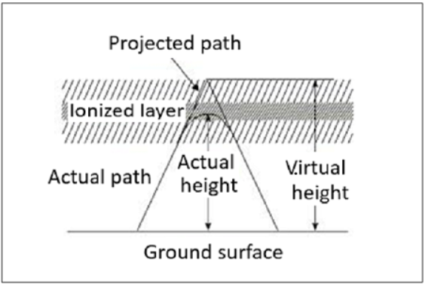
Important parameters
Virtual Height
When a wave is refracted, it is bent down gradually, but not sharply. However, the path of incident wave and reflected wave are same if it is reflected from a surface located at a greater height of this layer. Such a greater height is termed as virtual height.
The figure clearly distinguishes the virtual height (height of wave, supposed to be reflected) and actual height (the refracted height). If the virtual height is known, the angle of incidence can be found.
(H)
(h)

Slide 20
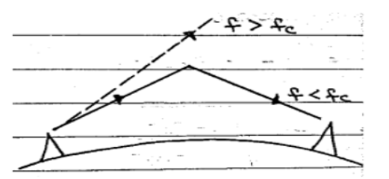
Important parameters
Critical Frequency
Critical frequency for a layer determines the highest frequency that will be returned down to the earth by that layer, after having been beamed by the transmitter, straight up into the sky.
The rate of ionization density, when changed conveniently through the layers, the wave will be bent downwards. The maximum frequency that gets bent and reaches the receiver station with minimum attenuation, can be termed as critical frequency. This is denoted by f_{c}.

Slide 21
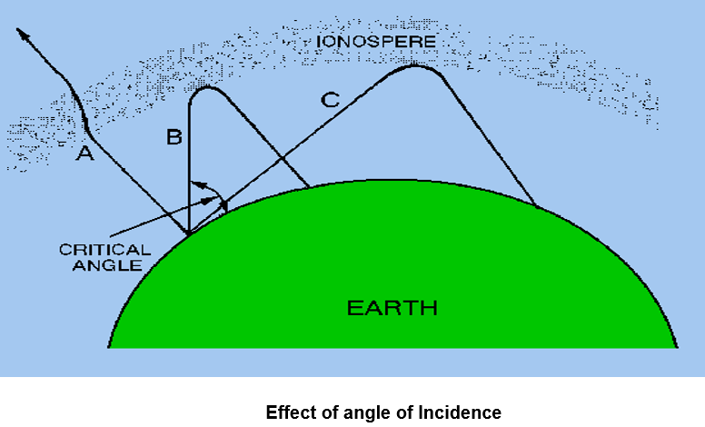
Important parameters
Incidence Angle
The projection angle from the transmitter at which the wave is made to enter ionosphere layer dictates the rate of refraction. In the given figure below strike angle of wave A is nearly vertical and hence it is slightly diverted and finally moves out in space. As the angle is decreased, it contacts ionosphere and is reflected towards receiver.
Wave B is at critical angle keeping in view the frequency
of operation. Waves that are transmitted by transmitter at
larger angles will enter ionosphere and will disappear.
Waves transmitted at a lower angle (wave C) can be
reflected back by ionosphere. Waves having angles
smaller than angle of wave C will be lost.

Slide 22
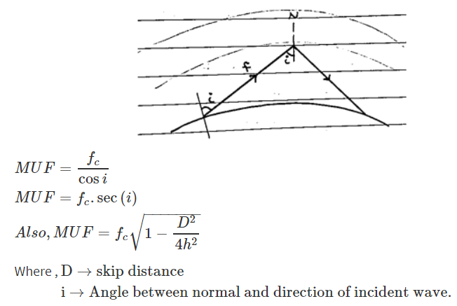
Important parameters
Maximum Usable Frequency (MUF)
The Maximum Usable Frequency (MUF) is the highest frequency delivered by the transmitter regardless of the power of the transmitter. The highest frequency, which is reflected from the ionosphere to the receiver is called as critical frequency, fc.

Slide 23
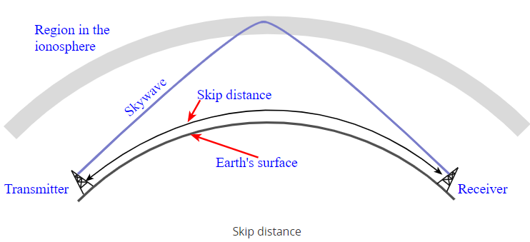
Important parameters
Skip Distance
The measurable distance on the surface of the Earth from transmitter to receiver, where the signal reflected from the ionosphere can reach the receiver with minimum hops or skips, is known as skip distance
The SKIP DISTANCE is the distance from the transmitter to the point where the sky wave is first returned to Earth. The size of the skip distance depends on the frequency of the wave, the angle of incidence, and the degree of ionization present.

Slide 24
Important parameters
Skip Distance
The skip distance is dependent upon a variety of factors:
Frequency: The frequency of operation has a major influence on the skip distance that can be achieved. Typically as the frequency increases a lower angle of radiation is needed to return the signals to Earth in a shorter distance. Also higher frequencies tend to be reflected or refracted by higher layers or regions in the ionosphere. This will mean that higher frequencies tend to lead to longer skip distances.
Ionospheric conditions: The ionospheric conditions play a major role in governing the skip distance. Under some circumstances when ionization levels are high it may be possible for signals to achieve very short skip distances.
Angle of radiation: The angle of radiation from the transmitting antenna will also have an impact on the skip distance. A lower angle of radiation will lead to longer skip distances as a result of the geometry.

Slide 25
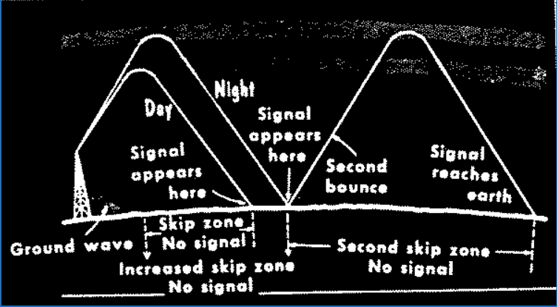
Important parameters
Skip Zone
The skip zone is a zone of silence between the point where the sky wave is first returned to earth, i.e. between transmitter & receiver for skip distance.
The SKIP ZONE is a zone of silence between the point where the ground wave becomes too weak for reception and the point where the sky wave is first returned to Earth. The size of the skip zone depends on the extent of the ground wave coverage and the skip distance.
When the ground wave coverage is great enough or the skip distance is short enough that no zone of silence occurs, there is no skip zone.
Occasionally, the first sky wave will return to Earth within the
range of the ground wave. If the sky wave and ground wave are
nearly of equal intensity, the sky wave alternately reinforces and
cancels the ground wave, causing severe fading. This is caused
by the phase difference between the two waves, a result of the
longer path traveled by the sky wave.

Slide 26


